Slide 1




35th
STEMIE Fairs
18th
2021-2022
65th

Slide 2
Workshop Hosts
Lee Hughes
Lee County K-12 STEM Coordinator
CO Chair, Regional Science & Engineering Fair
Kristie Kennedy
Director of Elementary Science Expo
Orange River Elementary
Jenifer McBride
Lee County Elementary Science Specialist
Honora Kenney, BS, MS, Ed. Admin.
Interim Regional Inventors Fair School Coordinator
Teacher & Administrator, Retired
Connecticut Invention Convention Administrator 30+yr
Gary Nelson, DVM Retired, PTE
CO Chair, Regional Inventors Fair
G

Slide 3
The Problem We All Face
“We are attempting to educate students today
so that they will be ready to solve future problems
that have not yet been identified
using technologies not yet invented
based on scientific knowledge not yet discovered.”
-Talents Unlimited
H

Slide 4
TAERSIF Promotes
  Academic Skills thru Research and Collaboration
    Reading, Writing, Arithmetic/Mathematics, Listening /Speaking
  Personal Qualities thru Engagement
    Responsibility, Self-Esteem, Sociability, Self-Management, Integrity/Honesty)
  Thinking Skills thru Discovery, Application & Revision
    Creative Thinking, Decision Making, Problem Solving, Seeing Things in the Mind’s Eye, Knowing How to Learn, Reasoning, Entrepreneurship
H

Slide 5
Our Program Goals
Provide children with FUN meaningful opportunities to develop & encourage creative thinking and invention.
Address society’s need for innovation and invention through education.
Stimulate students to pursue interest in science and engineering.
Not all children become engineers or inventors but we want all to retain a life-long creative mindset, capable of integrating problem solving into any career.
Ensures Inventive Spirit & Skill throughout life.
H

Slide 6
Why We Teach STEMIE
“Innovation Literacy”
The ability to think creatively, evaluate, and apply problem-solving skills to diverse and intangible issues within problems and multidisciplinary contexts.
It can and should be taught.
Play is the highest form of research.
Albert Einstein
H

Slide 7


STEMIE Utilizes Howard Gardner’s Multiple Intelligences
Linguistic intelligence
Logical-mathematical intelligence
Musical intelligence
Bodily-kinesthetic intelligence
Spatial intelligence
Interpersonal intelligence
Intrapersonal intelligence
H

Slide 8
Inquiry is Vital to Science Ed
From I N S T I T U T E F O R I N Q U I R Y: www. e x p l o r a t o r i u m . e d u / i f i © E x p l o r a t o r i u m
Good science education requires both learning scientific concepts and developing scientific thinking skills.
Inquiry is an approach to learning that involves a process of exploring the natural or material world.
Inquiry leads to asking questions, making discoveries, and testing those discoveries in the search for new understanding.
Inquiry, as it relates to science education, should mirror as closely as possible the enterprise of doing real science.
Inquiry is the basis of science education.
H

Slide 9
How do YOU identify problems
Pay attention - Be observant.
Use all your “5” senses.
Brainstorm with other people.
Take small steps to BIG changes.
“Catch ideas” in writing or recordings. Do not allow them to escape or be forgotten!
H

Slide 10
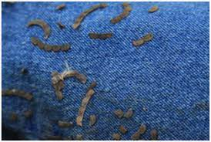
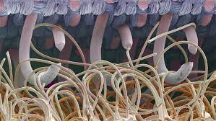
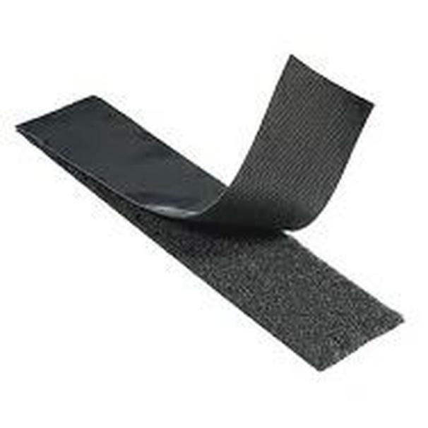
Discovery through Biomimicry -
This is a GEM! http://biomimicry.org
Inquiry
led scientist George de Mestral
to study the pesky Hitch Hiker weed
with his microscope leading to the
discovery enabling ‘engineering’
of the product ‘Velcro”.
G

Slide 11
Pay Attention to What’s All Around . . .
And try to mimic the marvels of nature!
Look for something that goes right
when you least expect it to!
Stay alert to changes & unexpected events!
Including opportunities created by new laws & regulations!
G

Slide 12

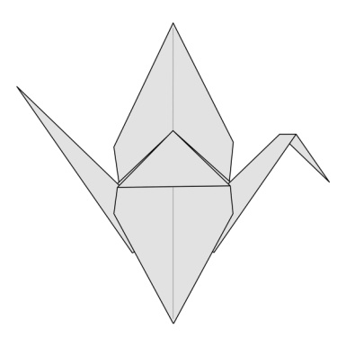
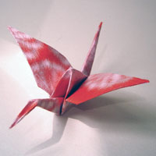
Application of Origami . . .
led physicist and origami master Robert Lang
in the engineering of the folding of solar arrays!
‘Play’ can lead to the extraordinary!
G

Slide 13

Take small steps to BIG changes
BAR CODE
Numbers are represented
by one or more bars
of varying thickness.
INVENTORY
A Retail Category
B Manufacturer
C Product Code
D Check Character
A ----B---- ----C---- D
From the left
Add all odd positions 2+4+6+8+0 = 20
Add all even positions 1+3+5+7+9 = 25
Multiply odd position sum by 3 = 60
3x (odd positions) + sum of even positions = 85
Subtract the sum from the nearest multiple of ten 90 – 85 = 5
This is the Check Character !!!
G

Slide 14
The Butterfly Alphabet
Reverse Biomimicry?
Eye catching DISPLAY!
Smithsonian photographer
compiled this from butterfly photos personally taken around the world.
G

Slide 15
“Walk in the other person’s shoes”
  Wear gloves & try to tie shoelaces, button a blouse or shirt to simulate having arthritis.
  What did a deaf student invent for an alarm clock? A pillow that vibrates on a time!
  What did a student inventor create to help the blind know the correct medicine bottle to select and how many pills to take?
  A Braille Drug Label!
H

Slide 16
Brainstorm using Bob Eberle’s
Scamper Technique
Engineering Ideas
Substitute
Combine
Adapt
Resize - maximize or minimize
Rearrange
Reverse
Eliminate
Put to other use
H

Slide 17

What Scamper Techniques are used in Smart Phones?
Combine, Resize, Adapt, Rearrange – Phone, Computer, Camera, Adding Machine, Dictionary, Media Center, Catalog, Library, Financial Institutions. . .
This introduces a new way of looking at value of a product in terms of Time & Price.
Ask yourself how much time it would take to produce and pay for all the items separately verses the time-price of a smart phone?
Time-Price is Progress.
H

Slide 18
Innovations and improvements of the “Simple” CLOTHES HANGER
How many different kinds can you think of ?
One holds a shirt.
Another holds pants and a shirt.
A swivel hook allows you to turn the hanger.
A bar is added to prevents slipping pants.
Another has clips to secure a dress or pants.
Hooks are added to hang accessories.
Each one is a helpful innovation!
H

Slide 19
“Failure” is Learning What Not to Do. And Yet,
Great Products Arise From Failure.
Post-It Notes uses a ‘failed’ adhesive that was meant to be very strong but instead released easily.
How many times did experiments fail to create a water disbursement product to prevent rusting of rockets on the foggy California launch pad? FORTY!
The product? WD 40.
H

Slide 20
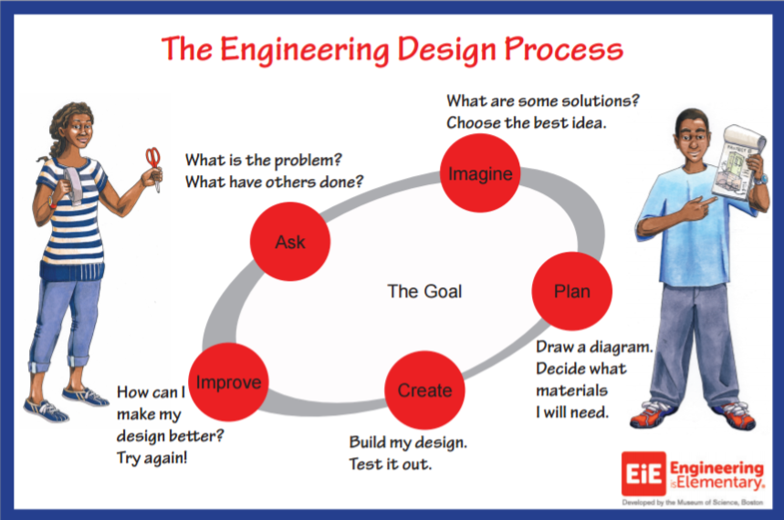
Engineering is the First ‘E’ in STEMIE
H
Notes:
Add STEMIE coalition flow chart

Slide 21
Science and Invention Valued Resources
https://inhub.thehenryford.org/icw/home
https://www.fldoe.org/academics/standards/subject-areas/math-science/science/
https://www.nsta.org/
https://www.edisonfairs.org
Resources for Lesson Plans and more
G

Slide 22
A Virtual Inventors Fair, Again!
Important Dates
October 1st - School and teacher registration to begin on Google Classroom
Register school, teacher and finalists on zFairs promptly following school competitions
January 26th - zFairs paperwork and video uploading closes
February 5th -12th – zFairs Judging of Paperwork and Video
February 19th - Limited Virtual Interviews for Ties Only
Regional Awards Program on Lee School Network in early March TBA
https://fl-rif.zfairs.com/?f=3d80efb7-e4a8-4439-9360-d98dd093782f
G
Notes:
Highlights: Yes, virtual; virtual judging and video submissions; updated website, updated logbooks

Slide 23
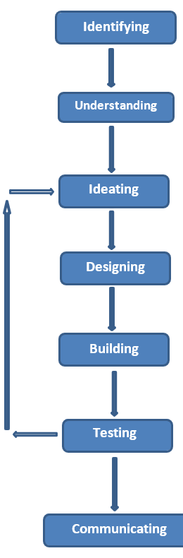
Invention Process Overview
Identifying a problem is when you brainstorm and use research to discover problems and who might have these problems. You might uncover these problems at home, at your school, with your sports or games, listening to the news or somewhere else entirely.
Understanding a problem is when you know what is causing the problem and exactly what you want to happen when the problem is solved. The better you understand the problem, the better your solution will be.
Ideating means thinking about the problem, brainstorming and researching different ideas and options to solve the problem.
Designing is when you decide what your invention solution will be made of, what it will look like and how it will work.
Building is when you assemble your invention together based on your solution design using the materials and the process you have decided to use.
When Testing your solution, you will find what works and what doesn’t. You will modify or change your design, then build in those new changes, and test the changes. The testing also includes an analysis of the Pros and Cons of the invention, its impact on society and the environment, its marketability and social value. You keep repeating this process until your invention or prototype works and works well.
Communicating is when you explain the problem and your research, how your invention solution solves the problem, who might use your invention, your process in creating this invention, and how you might make it even better.
Source:
Henry Ford
Invention
Convention
Worldwide
G

Slide 24


Inventor’s Log
Additional Templates available from the National or member affiliates.
Connecticut affiliate has a log in espanol !
https://www.edisonfairs.org
Select a logbook from the affiliate resources provided.
The teacher must sign off on the problem solution and on completion.
Parent/Guardian signature required for permission to compete.
K-3 4-12
https://inhub.thehenryford.org/icw/home
G
https://inventionconvention.org/CT/
espanol

Slide 25
Logbook Tips
All Student Inventors Logbooks should clearly distinguish student entries and illustrations from the teaching information in the Guide.
Older students may create their final logbook without including the logbook teaching guides.
Younger students are not expected to provide the same depth of information or research as older more knowledgeable and experienced students.
G

Slide 26
Logbook Tips
NEW RECOMMENDATIONS
Summary-Abstract.
Summarize the essential points of the invention.
This will become the first page of the logbook.
Logbook Preparation for Judging.
Look at it through the eyes of a judge and
organize responses, data, and illustrations
following the Invention Logbook Criteria.
.
G

Slide 27
Invention Logbook Criteria
A GREAT Logbook provides thorough documentation from beginning to end, accurately detailing the inventors thought process, research, and development of the invention.
  Identifying & Understanding
  Ideating
  Proof of originality - ‘patent’ search, market search, plus any scientific research leading up to the invention
  Designing, Building, Testing & Refining leading up to the model or prototype presented
  Value Proposition
  Market Potential
  Communication Planning
  Any Entrepreneurial Planning and Actions
The final logbook does NOT require repeating the questions provided in any template logbook. Section headings are just fine!
G

Slide 28
One thing leads to another . . .
A great Logbook
provides great resources
for a great Display Board.
A great Display Board
serves as a prompt or ‘cue cards’
for a great Video Presentation!
Videos should avoid Q & A formats.
G

Slide 29
EdisonFairs.org & zFairs.com
Working with 2022 Virtual Competition Registrations and File Transfers
Google Classroom (Google Education)
Verify on the edisonfairs.org website a Google Classroom listing of regional student participants and their student folders.
Google Classroom student folder paperwork files:
  Abstract/Summary (new in 2022),
  Logbook,
  Display Board : Digital or photos of Physical,
  Additional project photos such as the model or prototype.
All paperwork should be .pdf formatted.
Presentations: YouTube video. (YouTube.com: Create Video Content From Home - All Right From Your Desktop)
Bookmark the zFairs website
Register your School
Register yourself as Teacher
Following school competitions and selection of school finalists
  zFairs student registration needs to be completed
  Please encourage a parent /guardian email address and phone number for elementary and middle students.
  High school students have the preference to provide a personal or parent email address and phone number
Important Steps to Take for Regional Entries: (Snapshot Review) –link will be updated for new hosting site.
zFairs
https://fl-rif.zfairs.com/?f=3d80efb7-e4a8-4439-9360-d98dd093782f
G
Notes:
If you need help and most everyone does, there are many resources to choose from from the internet, to articles, magazines, and books, . . .
Organizations like the Edison Inventors Association and The Entrepreneur Society of Naples and Small Business Development Center. AND
You can network with fellow students, teachers, your parents and business people in the community. Be respectful of the time you ask from businesspersons. Prepare as well as you can and have questions prepared ahead of time. Finally, give credit for any help you receive. Make notations in your Log Book and have the people you talk to witness it by dating and signing their name as proof of their assitance.

Slide 30
Inspiration from a Student , a Teacher, and a CEO
Serena Kasai-Hazekamp
8th Grade Global Invention Competition Award Winner
“. . . My favorite guest speaker was William Kamkwamba (The Boy Who Harnessed the Wind). When he realized his family could no longer afford to pay for his schooling, he took his education into his own hands. He didn't allow his future to be dictated by his circumstances. Despite facing many challenges, he never gave up nor did he let anyone talk him out of his ambitions. His story showed me that one does not need experience or age to make a difference in the world or one’s own community; just the ability to believe in yourself and the will not not give up . . . “
G

Slide 31
Inspiration from a Student, a Teacher, and a CEO
A teacher’s perspective of the Edison Young Inventors Program leading up to the Thomas A. Edison Regional Science & Inventors Fairs Competition: “It’s creativity and a different way of learning,” Gateway teacher Marsha Malamut said. The inventions make students use math, science, creative thinking, financial and marketing planning and other skills. “It incorporates every skill a teacher could possibly want, in a free-form way.”
" As I see it, to be an inventor creativity is key, but learning how to think and how to plan your actions is also important. Take the time to analyze situations and learn how to solve the problems you find along the way. Most important, do not let old ways of thinking blind you to new possibilities. New ways and new ideas have written many of the best success stories in history." " Good luck to all of the participants in the Inventors Program.” William Clay Ford, Jr.
Great Grandson of Henry Ford
Chairman of the Board, Ford Motor Company
G

Slide 32

In Conclusion
Why Have an Invention Program?
fosters enthusiasm for new learning
is not limited to gender, race, creed or color
involves interdisciplinary studies
challenges the application of knowledge
broadens and tests research skills
provides life long tools to succeed
grows an appreciation for everyday things
motivates through example
improves self confidence
generates new experiences
promotes networking
prepares for future careers
can be a stepping stone to entrepreneurship
H

Slide 33

Thank you!
Honora Kenney
BS, MS, Ed. Admin.
hrk34@aol.com
Gary H. Nelson
DVM, PTE
drghn@aol.com
“Innovation is the child of freedom and the parent of prosperity.”
Matt Ridley (How Innovation Works)

Slide 34
Questions?
School must be registered by October 15, 2021 on EdisonFairs.org for Title IV coverage of school registration $150 fee.
2022 Project Allotments:
  MINIMUM 6 projects/school
  1 add’l regional fair project/ 15 projects in school fair
  MAXIMUM 15
  Final approval by Fair Officials

